Slide 1

Operating Systems Design​ Session 35: Thread API and Condition Variables
19CS2106R​
© 2020 KL University

Slide 2
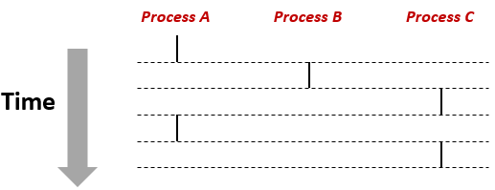
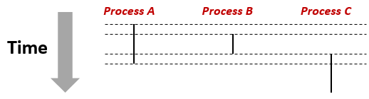
Concurrency vs. Parallelism
Concurrency: 2 processes or threads run concurrently (are concurrent) if their flows overlap in time
Otherwise, they are sequential.
Examples (running on single core):
Concurrent: A & B, A & C
Sequential: B & C
Parallelism: requires multiple resources to execute multiple processes or threads at a given time instant. A&B parallel:

Slide 3
Thread Concepts
A typical UNIX process can be thought of as having a single thread of control: each process is doing only one thing at a time. With multiple threads of control, we can design our programs to do more than one thing at a time within a single process, with each thread handling a separate task. This approach can have several benefits.
We can simplify code that deals with asynchronous events by assigning a separate thread to handle each event type. Each thread can then handle its event using a synchronous programming model. A synchronous programming model is much simpler than an asynchronous one.
Multiple processes have to use complex mechanisms provided by the operating system to share memory and file descriptors. Threads, on the other hand, automatically have access to the same memory address space and file descriptors.
Some problems can be partitioned so that overall program throughput can be improved. A single process that has multiple tasks to perform implicitly serializes those tasks, because there is only one thread of control. With multiple threads of control, the processing of independent tasks can be interleaved by assigning a separate thread per task. Two tasks can be interleaved only if they don't depend on the processing performed by each other.
Similarly, interactive programs can realize improved response time by using multiple threads to separate the portions of the program that deal with user input and output from the other parts of the program.

Slide 4
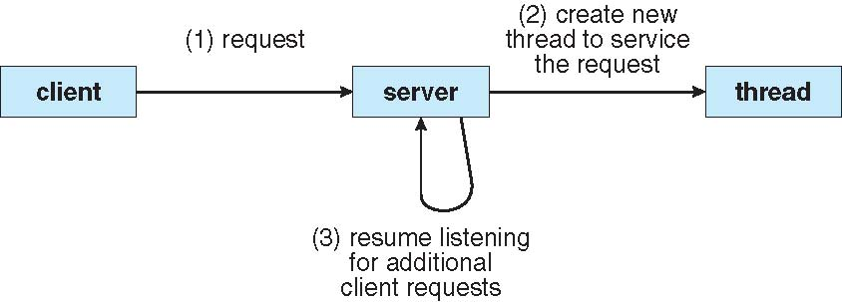
Multithreading Example: WWW
Client (Chrome) requests a page from server (amazon.com).
Server gives the page name to the thread and resumes listening.
Thread checks the disk cache in memo; if page not there, do disk I/O; sends the page to the client.

Slide 5
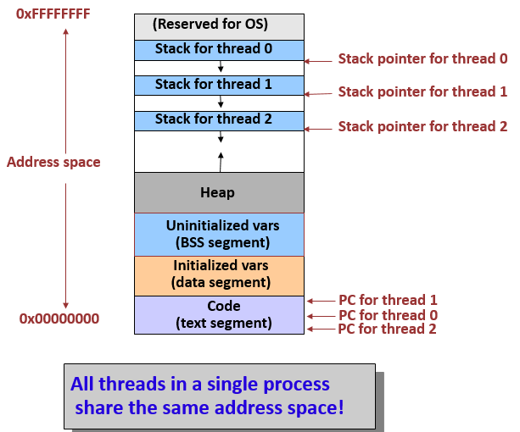
(New) Process Address Space w/ Threads

Slide 6
Thread State
State shared by all threads in process:
Memory content (global variables, heap, code, etc).
I/O (files, network connections, etc).
A change in the global variable will be seen by all other threads (unlike processes).
State private to each thread:
Kept in TCB (Thread Control Block).
CPU registers, program counter.
Stack (what functions it is calling, parameters, local variables, return addresses).
Pointer to enclosing process (PCB).

Slide 7
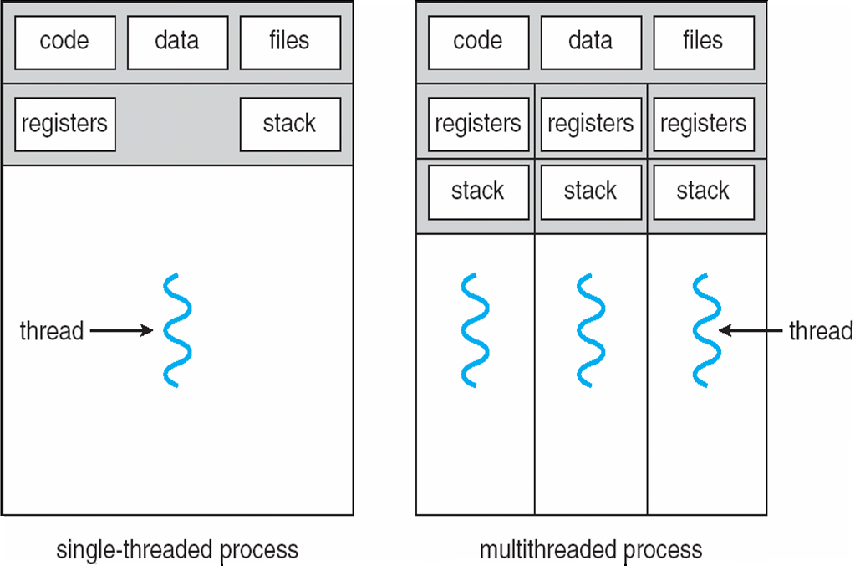
Single- vs. Multi-threaded Processes
Shared and private stuff:

Slide 8
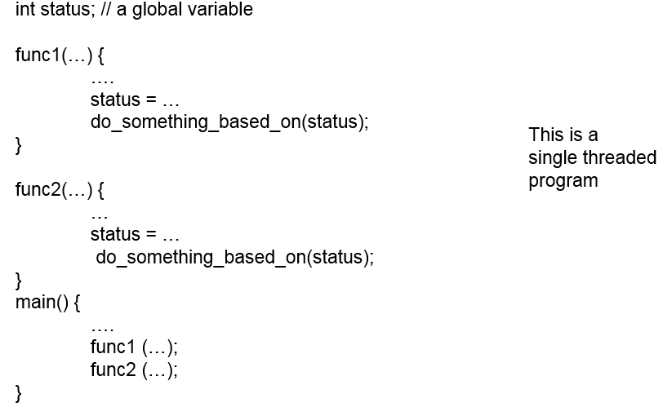
Single- to Multi-thread Conversion
Careful with global variable:

Slide 9
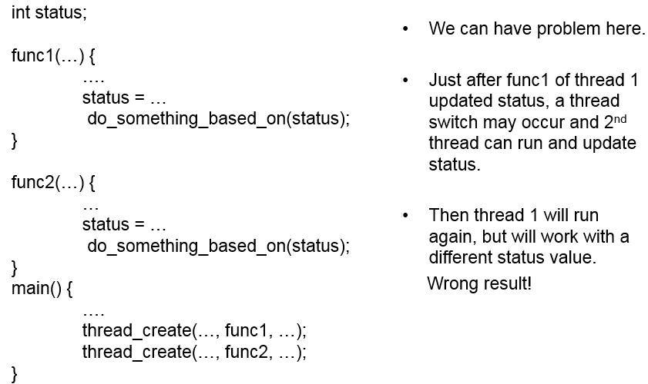
Single- to Multi-thread Conversion
Careful with global variable:

Slide 10
Thread Creation
How to create and control threads?
thread: Used to interact with this thread.
attr: Used to specify any attributes this thread might have.
Stack size, Scheduling priority, …
start_routine: the function this thread start running in.
arg: the argument to be passed to the function (start routine)
a void pointer allows us to pass in any type of argument.
#include <pthread.h>
int
pthread_create( pthread_t* thread,
const pthread_attr_t* attr,
void* (*start_routine)(void*),
void* arg);

Slide 11
Thread Identification
Recall that a process ID, represented by the pid_t data type, is a non-negative integer. A thread ID is represented by the pthread_t data type. Implementations are allowed to use a structure to represent the pthread_t data type, so portable implementations can't treat them as integers. Therefore, a function must be used to compare two thread IDs.
#include <pthread.h> int pthread_equal(pthread_t tid1, pthread_t tid2);
Returns: nonzero if equal, 0 otherwise
11

Slide 12
Thread Identification
A thread can obtain its own thread ID by calling the pthread_self function.
#include <pthread.h> pthread_t pthread_self(void);
Returns: the thread ID of the calling thread
This function can be used with pthread_equal when a thread needs to identify data structures that are tagged with its thread ID. For example, a master thread might place work assignments on a queue and use the thread ID to control which jobs go to each worker thread.

Slide 13
Thread Termination
If any thread within a process calls exit, _Exit, or _exit, then the entire process terminates. Similarly, when the default action is to terminate the process, a signal sent to a thread will terminate the entire process.
A single thread can exit in three ways, thereby stopping its flow of control, without terminating the entire process.
The thread can simply return from the start routine. The return value is the thread's exit code.
The thread can be canceled by another thread in the same process.
The thread can call pthread_exit.
#include <pthread.h>
void pthread_exit(void *rval_ptr);
The rval_ptr is a typeless pointer, similar to the single argument passed to the start routine.
This pointer is available to other threads in the process by calling the pthread_join function.
13

Slide 14
Wait for a thread to complete
#include <pthread.h>
int pthread_join(pthread_t thread, void **rval_ptr);
Returns: 0 if OK, error number on failure
The calling thread will block until the specified thread calls pthread_exit, returns from its start routine, or is canceled. If the thread simply returned from its start routine, rval_ptr will contain the return code. If the thread was canceled, the memory location specified by rval_ptr is set to PTHREAD_CANCELED.
By calling pthread_join, we automatically place a thread in the detached state (discussed shortly) so that its resources can be recovered. If the thread was already in the detached state, calling pthread_join fails, returning EINVAL.
If we're not interested in a thread's return value, we can set rval_ptr to NULL. In this case, calling pthread_join allows us to wait for the specified thread, but does not retrieve the thread's termination status.
14

Slide 15
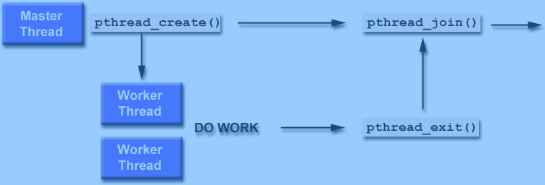
Joining
15

Slide 16
Detach
The pthread_detach()routine can be used to explicitly detach a thread even though it was created as joinable
There is no converse routine
Recommendations:
If a thread requires joining, consider explicitly creating it as joinable
This provides portability as not all implementations may create threads as joinable by default
If you know in advance that a thread will never need to join with another thread, consider creating it in a detached state
Some system resources may be able to be freed.
16

Slide 17
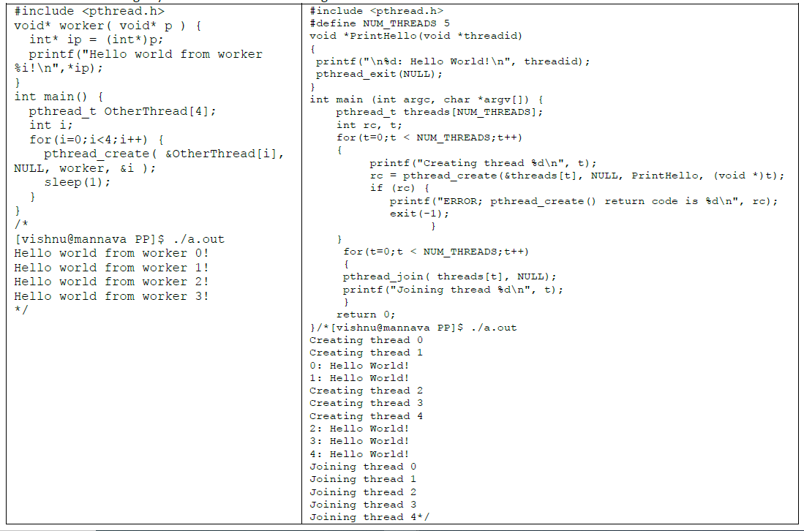
17

Slide 18
Locks
a synchronization mechanism for enforcing limits on access to a resource in an environment where there are many threads of execution
Provide mutual exclusion to a critical section
Interface
Usage (w/o lock initialization and error check)
No other thread holds the lock → the thread will acquire the lock and enter the critical section.
If another thread hold the lock → the thread will not return from the call until it has acquired the lock.
int pthread_mutex_lock(pthread_mutex_t *mutex);
int pthread_mutex_unlock(pthread_mutex_t *mutex);
pthread_mutex_t lock;
pthread_mutex_lock(&lock);
x = x + 1; // or whatever your critical section is
pthread_mutex_unlock(&lock);
18

Slide 19
Locks (Cont.)
All locks must be properly initialized.
One way: using PTHREAD_MUTEX_INITIALIZER
The dynamic way: using pthread_mutex_init()
pthread_mutex_t lock = PTHREAD_MUTEX_INITIALIZER;
int rc = pthread_mutex_init(&lock, NULL);
assert(rc == 0); // always check success!
19
Youjip Won

Slide 20
Locks (Cont.)
Check errors code when calling lock and unlock
An example wrapper
These two calls are used in lock acquisition
trylock: return failure if the lock is already held
timelock: return after a timeout
// Use this to keep your code clean but check for failures
// Only use if exiting program is OK upon failure
void Pthread_mutex_lock(pthread_mutex_t *mutex) {
int rc = pthread_mutex_lock(mutex);
assert(rc == 0);
}
int pthread_mutex_trylock(pthread_mutex_t *mutex);
int pthread_mutex_timelock(pthread_mutex_t *mutex,
struct timespec *abs_timeout);
20

Slide 21
Locks (Cont.)
These two calls are also used in lock acquisition
trylock: return failure if the lock is already held
timelock: return after a timeout or after acquiring the lock
int pthread_mutex_trylock(pthread_mutex_t *mutex);
int pthread_mutex_timelock(pthread_mutex_t *mutex,
struct timespec *abs_timeout);
21

Slide 22
Condition Variables
A condition variable allows a thread to block itself until specified data reaches a predefined state.
A condition variable is associated with a predicate.
When the predicate becomes true, the condition variable is used to signal one or more threads waiting on the condition.
A single condition variable may be associated with more than one predicate.
A condition variable always has a mutex associated with it.
A thread locks this mutex and tests the predicate defined on the shared variable.
If the predicate is not true, the thread waits on the condition variable associated with the predicate using the function pthread_cond_wait.

Slide 23
Condition Variables
Condition variables are useful when some kind of signaling must take place between threads.
pthread_cond_wait:
Put the calling thread to sleep.
Wait for some other thread to signal it.
pthread_cond_signal:
Unblock at least one of the threads that are blocked on the condition variable
A condition variable is a data object that allows a thread to suspend execution until a certain event or condition occurs.
When the event or condition occurs another thread can signal the thread to “wake up.”
int pthread_cond_wait(pthread_cond_t *cond, pthread_mutex_t *mutex);
int pthread_cond_signal(pthread_cond_t *cond);
23

Slide 24
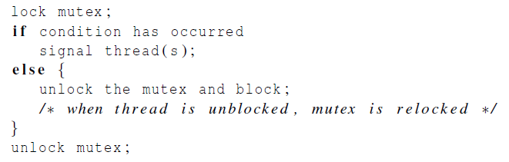
Condition Variables (Cont.)
A thread calling wait routine:
The wait call releases the lock when putting said caller to sleep.
Before returning after being woken, the wait call re-acquire the lock.
A thread calling signal routine:
pthread_mutex_t lock = PTHREAD_MUTEX_INITIALIZER;
pthread_cond_t init = PTHREAD_COND_INITIALIZER;
pthread_mutex_lock(&lock);
while (initialized == 0)
pthread_cond_wait(&init, &lock);
pthread_mutex_unlock(&lock);
pthread_mutex_lock(&lock);
initialized = 1;
pthread_cond_signal(&init);
pthread_mutex_unlock(&lock);
24

Slide 25
Condition Variables (Cont.)
The waiting thread re-checks the condition in a while loop, instead of a simple if statement.
Without rechecking, the waiting thread will continue thinking that the condition has changed even though it has not.
pthread_mutex_t lock = PTHREAD_MUTEX_INITIALIZER;
pthread_cond_t init = PTHREAD_COND_INITIALIZER;
pthread_mutex_lock(&lock);
while (initialized == 0)
pthread_cond_wait(&init, &lock);
pthread_mutex_unlock(&lock);
25

Slide 26
Condition Variables (Cont.)
Don’t ever to this.
A thread calling wait routine:
A thread calling signal routine:
It performs poorly in many cases. → just wastes CPU cycles.
It is error prone.
while(initialized == 0)
; // spin
initialized = 1;
26

Slide 27
Compiling and Running
To compile them, you must include the header pthread.h
Explicitly link with the pthreads library, by adding the –lpthread flag.
For more information,
prompt> gcc –o main main.c -lpthread
man 7 pthreads
man 3 pthread_create
27

Slide 28
/* A simple child/parent signaling example. - main-signal.c */
#include <stdio.h>
#include <pthread.h>
int done = 0;
void* worker(void* arg) {
printf("this should print first\n");
done = 1;
return NULL;
}
int main(int argc, char *argv[]) {
pthread_t p;
pthread_create(&p, NULL, worker, NULL);
while (done == 0)
;
printf("this should print last\n");
return 0;
}
/*
vishnu@mannava:~/threads$ cc main-signal.c -lpthread
vishnu@mannava:~/threads$ ./a.out
this should print first
this should print last
*/
28

Slide 29
/* A more efficient signaling via condition variables. - main-signal-cv.c */
#include <stdio.h>
#include <pthread.h>
/* simple synchronizer: allows one thread to wait for another structure "synchronizer_t" has all the needed data methods are:
init (called by one thread)
wait (to wait for a thread)
done (to indicate thread is done) */
typedef struct __synchronizer_t {
pthread_mutex_t lock;
pthread_cond_t cond;
int done;
} synchronizer_t;
synchronizer_t s;
void signal_init(synchronizer_t *s) {
pthread_mutex_init(&s->lock, NULL);
pthread_cond_init(&s->cond, NULL);
s->done = 0;
}
void signal_done(synchronizer_t *s) {
pthread_mutex_lock(&s->lock);
s->done = 1;
pthread_cond_signal(&s->cond);
pthread_mutex_unlock(&s->lock);
}
29

Slide 30
void signal_wait(synchronizer_t *s) {
pthread_mutex_lock(&s->lock);
while (s->done == 0)
pthread_cond_wait(&s->cond, &s->lock);
pthread_mutex_unlock(&s->lock);
}
void* worker(void* arg) {
printf("this should print first\n");
signal_done(&s);
return NULL;
}
int main(int argc, char *argv[]) {
pthread_t p;
signal_init(&s);
pthread_create(&p, NULL, worker, NULL);
signal_wait(&s);
printf("this should print last\n");
return 0;
}
/*
vishnu@mannava:~/threads$ cc main-signal-cv.c -lpthread
vishnu@mannava:~/threads$ ./a.out
this should print first
this should print last
*/
30

Slide 31
Thank you

